Slide 1
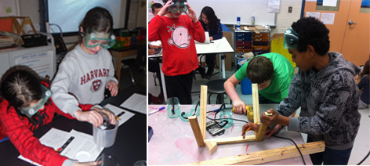
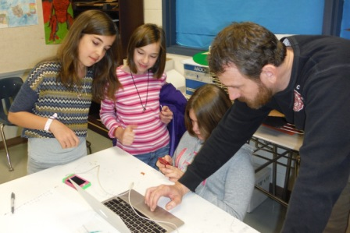

The Community Public
Charter School:
Program Evaluation Report
By William E. Deane, MBA, CSPT
Executive Summary Briefing to
ACPS School Board
December, 2014

Slide 2

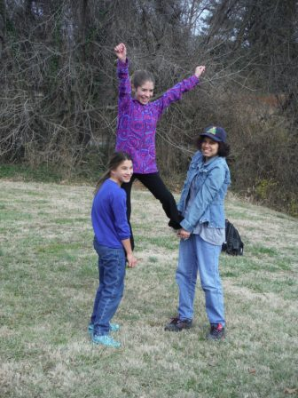

Purpose
A program evaluation was conducted
to evaluate the CPCS in terms of:
  Program methodologies
  Operating dynamics
  Measurable outcomes

Slide 3



Background Information
The CPCS opened as a charter school of ACPS in the fall of 2008
The school is designed to be an intervention for middle school students who are at-risk and falling significantly behind in their studies
Choice Theory and Mastery Learning concepts are employed in an arts-infused, project-based learning atmosphere

Slide 4


School Demographics
Currently, there are 44 students enrolled at CPCS
Among these students:
  50.0% are identified for SPED services
  34.1% are economically disadvantaged
  9.0% have limited English proficiency
  2.0% percent are gifted

Slide 5

Financial Statistics
CPCS began with $450,000 in federal grant funding
Upon exhaustion of grant funding, CPCS has received approximately 70-75% of its funding from ACPS (roughly $330,000 per year)
Total cost per student was approximately $10,369 in FY 14, compared to middle school average of $7794 (excluding division-level expenses, Building Services, Transportation, Child Nutrition)
Cost to ACPS per student was $7,776

Slide 6


Student Achievement
Given the demographics of the CPCS population, standardized test scores vary
Students who are falling behind grade level by one or more years attend CPCS as an intervention
Of 52 CPCS graduates, information is available for 49
  12 are current first semester 9th graders
  29 are on track to graduate on time or early (78%), based on the expectation of earning 6 credits per year in high school

Slide 7

Outcomes Explored
Discontinue the program: Students would return to middle schools, based on residence
  Small group interventions, based on need would be difficult to replicate at base schools
  There is no additional cost for operating the program
  A majority of students are on grade level
Continue the program “as is”: Make no changes to the operation of the school
  Metrics to determine efficacy of the program need to be re-defined
  Challenging dynamics of school operation should be explored for possible resolutions

Slide 8

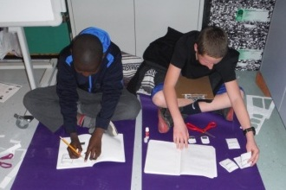
Recommendations
General Recommendation: Continue with modifications
Strategic Planning: Metrics regarding program efficacy bear revisiting
  Recommendation: Establish goals and benchmarks that clearly demonstrate the efficacy of CPCS programs, along with longitudinal measures of success for students

Slide 9

Recommendations
Challenging Dynamics and Recommendations:
  Classroom space utilization: Current learning space is distributed along 3 different hallways in Burley Middle School
    Recommendation: Review space utilization to determine if a cohesive block of classrooms is available
  Transportation: Current shuttle timing does not permit students to receive the same amount of instruction as other middle school students
    Recommendation: Review transportation options to determine if a school day of equivalent length to other middle schools is attainable

Slide 10

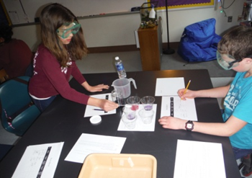
Recommendations
Challenging Dynamics and Recommendations:
  Recruiting and Staffing: Most applicants for CPCS vacancies are external and unfamiliar with ACPS, CPCS, and the school culture
    Recommendation: Utilize CPCS staff in Division-wide professional development to raise awareness of the program, choice theory, and mastery learning

